Slide 1
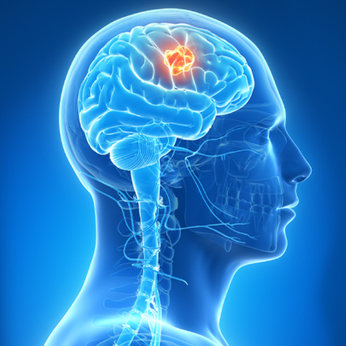
Deep learning final project
Contributors: Zachi Ben Shitrit Yonatan Boritski Avichay Mazin
Github - link

Slide 2

Table of Contents
Introduction
Dataset and preprocessing
Models Overview
Experiments
Models Evaluation and Results
Conclusions

Slide 3

Introduction
Finding brain tumors early is crucial for effective treatment. Doctors often use MRI or CT scans for this, but these scans can be expensive, and sometimes you have to wait a long time for an appointment.
We're exploring a new approach using X-ray pictures, which are more accessible and less costly. By using a computer technique called deep learning, we aim to improve X-rays ability to detect brain tumors. This technique teaches computers to recognize patterns that might indicate a tumor, something traditional methods might miss.
Our project looks at over 4,000 X-ray images to prove this method can work. Our goal is to help doctors everywhere spot brain tumors earlier without waiting for expensive scans. We believe in making advanced health tools available to everyone, no matter where they are.

Slide 4
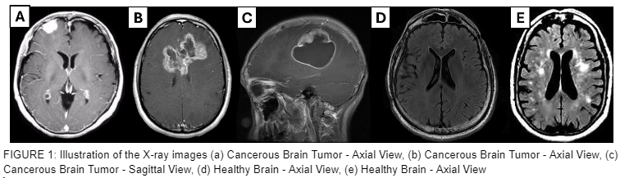
Dataset and preprocessing
Source: Kaggle, featuring 4,602 brain X-ray images.
Composition: Images include a mix of cancerous tumors and healthy brains, with 55% showing tumors.
Variety: Diverse resolutions and color modes (RGB and grayscale) across formats (JPEG, TIFF, PNG).
Views: Images captured from multiple angles (axial, coronal, sagittal) to provide comprehensive perspectives.

Slide 5
Preprocessing
Resizing: Uniformly resized all images to 128x128 pixels, ensuring the model receives input of consistent size, crucial for maintaining detail while managing computational load.
Normalization: Adjusted pixel values to a standard scale, converting images into tensors and scaling pixel values to improve the model's learning effectiveness by standardizing the range of input values.
Batch Processing: Organized images into batches of 64, enabling incremental weight updates during training. This approach speeds up the learning process and helps in reducing the likelihood of overfitting.
Additional Consideration: Managed the dataset variety in color modes and formats by standardizing image preprocessing, ensuring all images, whether RGB or grayscale, JPEG, TIFF, or PNG, are treated uniformly before feeding them into the model.
These steps are essential for preparing the brain X-ray images for training, ensuring the dataset is in the optimal format for the neural network to learn accurately and efficiently.

Slide 6
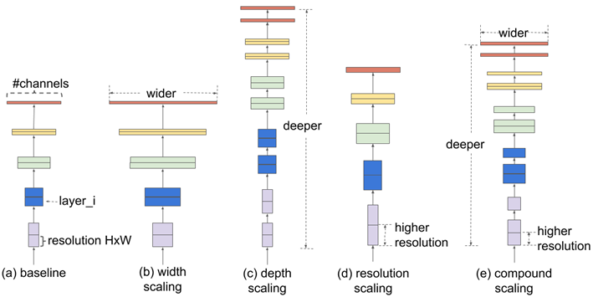
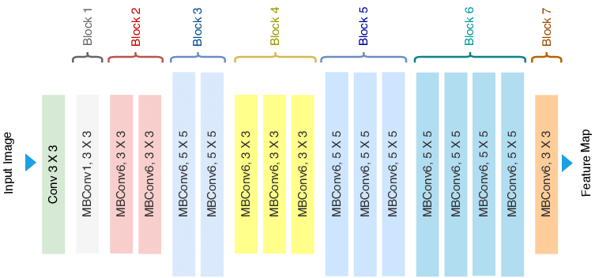
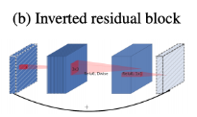
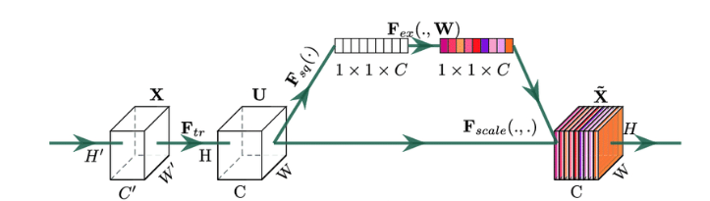
Models Overview
Efficient Net (weights initialized to 0)–
Compound Scaling:
Dynamic adjustment of width, depth, and resolution during training phase.
MBConv and SE Blocks
Incorporation of two advanced convolutional blocks for efficiency and performance enhancement.
Customization
Introduction of customized additional upper layers for adapting EfficientNetB0 to specific task.

Slide 7
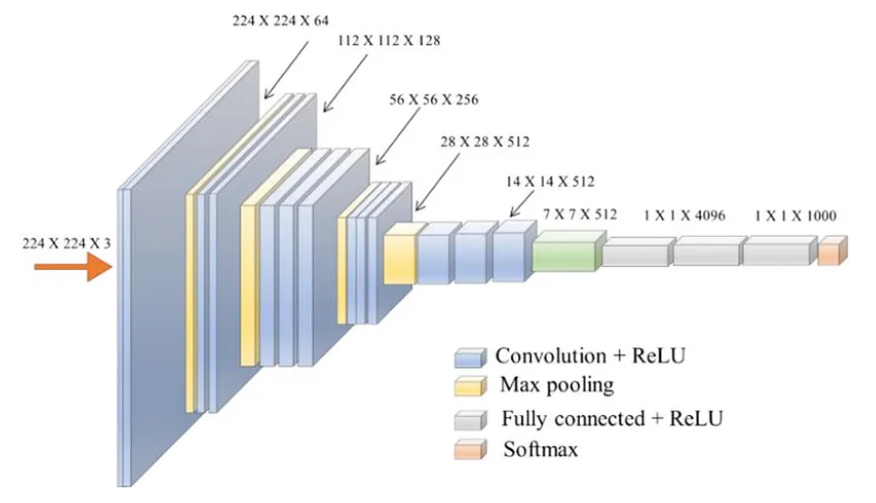

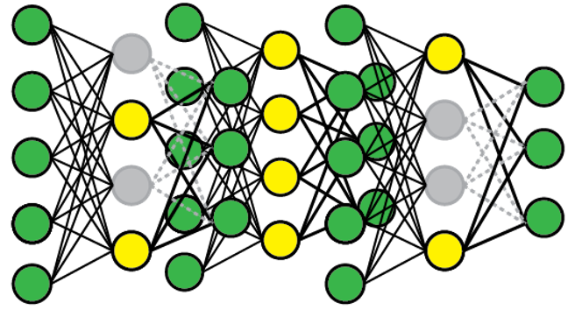
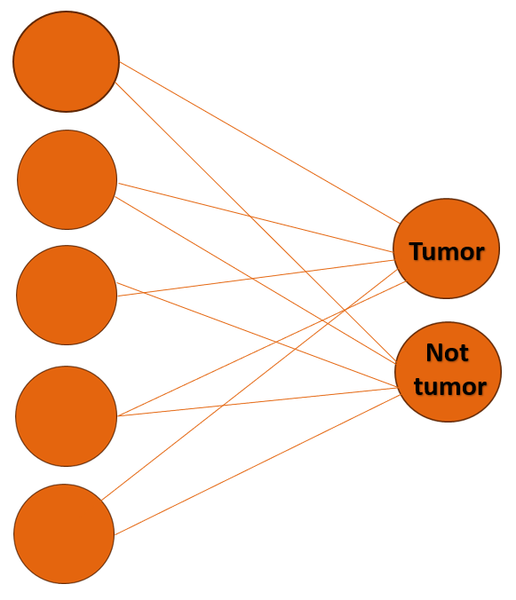

Models Overview
A
B
Efficient net fine tuned (weights initialized according to efficient net)–
This model was originally trained to recognize a wide variety of objects in pictures (trained on ImageNet – huge dataset). Our goal was to adapt this model to specifically detect brain tumors in X-ray images. To do this, we removed the model final layer, which decides what object is in an image (there is choise 1/1000), and we added two new layers. The first new layer randomly ignores some data to prevent the model from focusing too much on unimportant details, a technique known as 'dropout’ (was learned in lesson 7).
The second new layer makes the final decision: tumor or no tumor. By training this updated model with lots of brain X-ray images, some showing tumors and others not, the model learned to distinguish between the two.
C

Slide 8
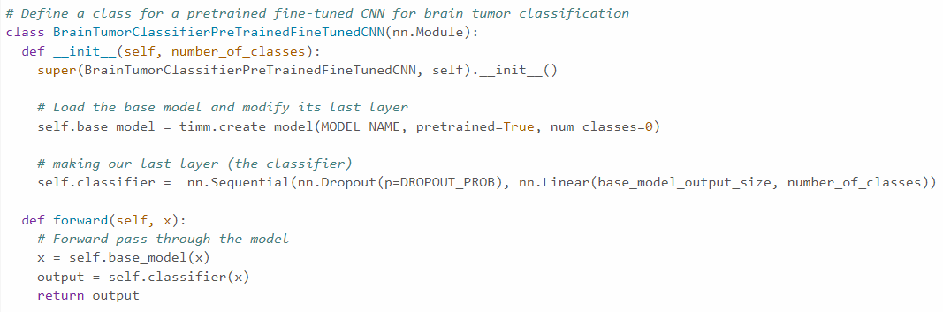
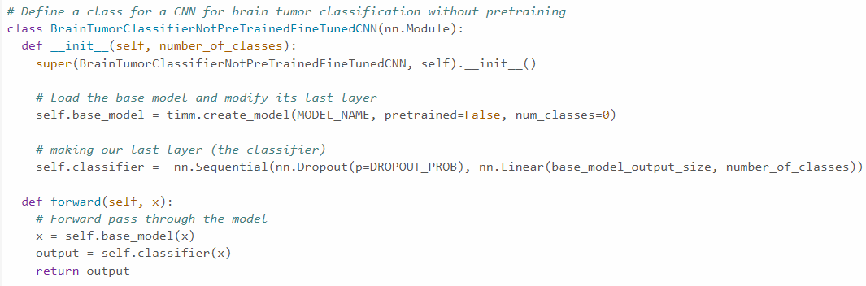
Models Overview – Efficient Net code
We take the efficient net that was trained before on ImageNet (big dataset), note that ‘pretrained=True’ which means we are using the weights of the pretrained model. We add to this 2 new layers, the first is dropout layer and the second is linear layer for the decision ‘tumor’ or ‘not tumor’.
Acts similar to the model above but note that ‘pretrained = False’ which means all the weights are initialized to 0 and the model learns directly our task.

Slide 9
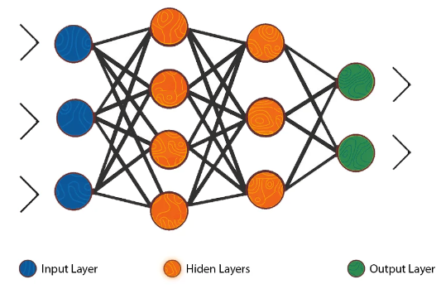
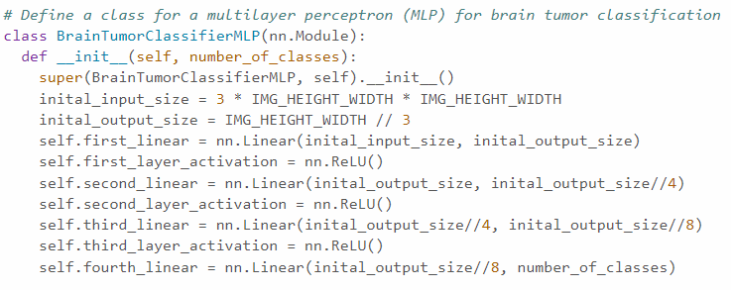
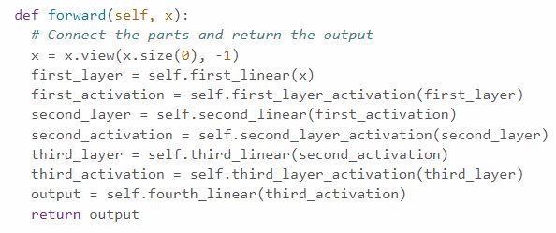
Models Overview
MLP – The MLP, or Multilayer Perceptron starting without prior image knowledge, learns from brain X-ray data by converting images into numbers and processing them through layers with 'ReLU' function to emphasize key features. Ultimately, it distinguishes between tumor and non-tumor images through learned patterns.
starts by adjusting the initial image size to fit the input layer, using the total pixel count. Then processes the image through several layers, each reducing the data size and refining features, using Relu activation function. The final layer decides if an image shows a tumor or not, based on the learned features.
Reshape ‘x’ (the image) to flatten array which is a long list of numbers. Then gradually simplifies and examines this list through several steps. Each step aims to highlight important features for making a decision. Finally, it uses what it has learned to make a prediction about the image

Slide 10
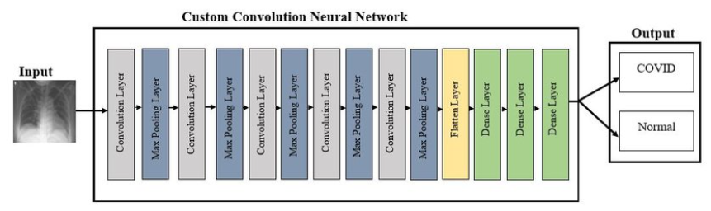
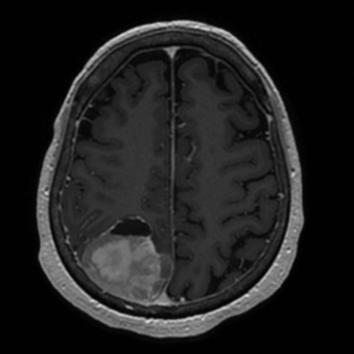
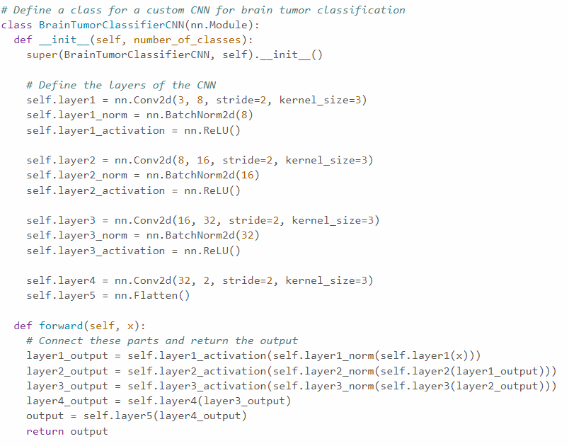
Models Overview
Custom CNN – This model is built from scratch to identify brain tumors in X-ray images. It processes images through multiple layers that filter and refine features, using techniques like batch normalization and ReLU activation to enhance learning. The final convolution layer prepares for the decision-making process, which is then flattened for classification. Through training on brain X-ray images, the model learns to differentiate between images with and without tumors, focusing on relevant patterns without prior knowledge from datasets like ImageNet.
Tumor
Not tumor
Build the layers by convolutional operations to analyze the images, using normalization and ReLU activation for stable and efficient feature extraction. The network progresses through increasing complexity to discern detailed features, culminating in a flattened output for classification
the input image x is sequentially processed through the CNN layers. Starting with the initial convolution, followed by normalization and activation to refine features, this process is repeated across multiple layers. Each stage extracts increasingly complex features, with the final convolution preparing the data for classification

Slide 11
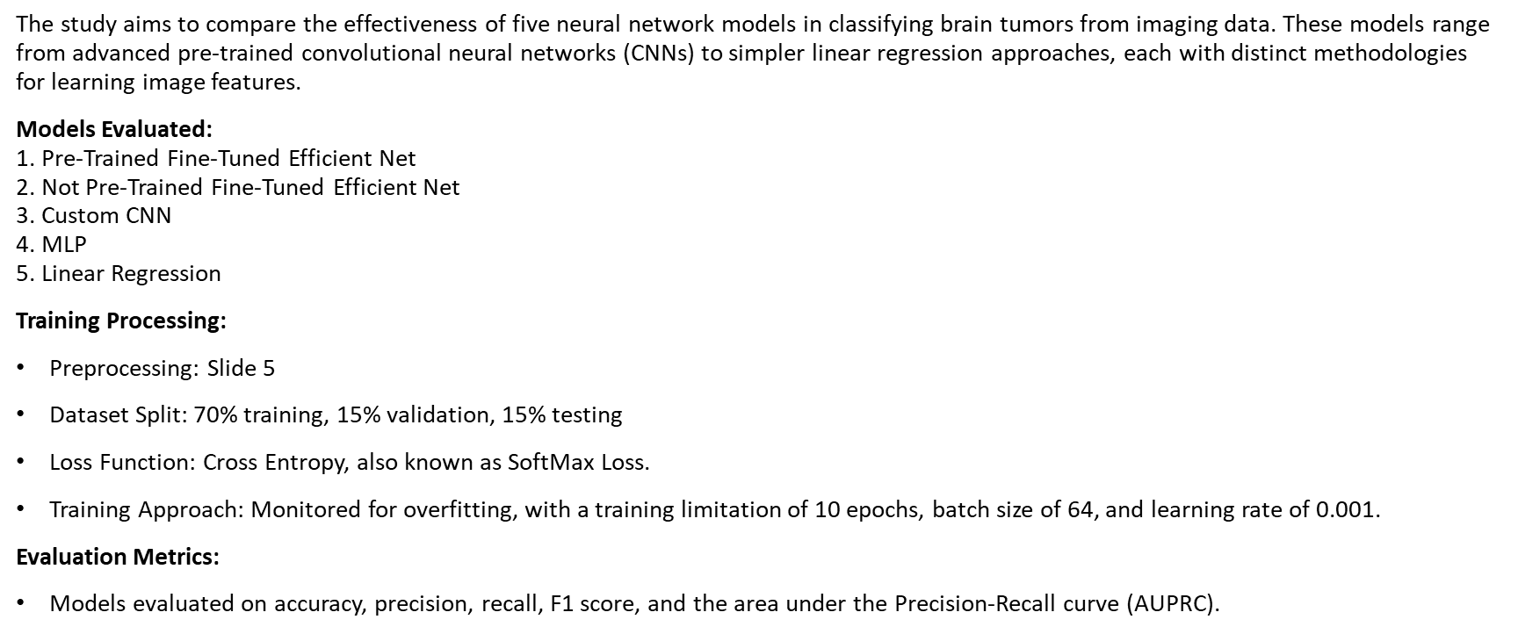
Experiments

Slide 12
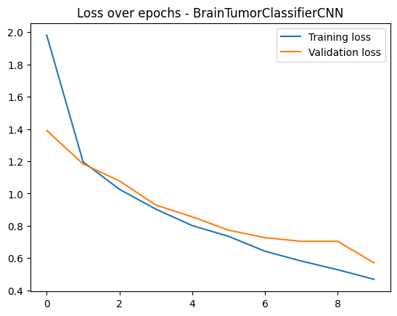
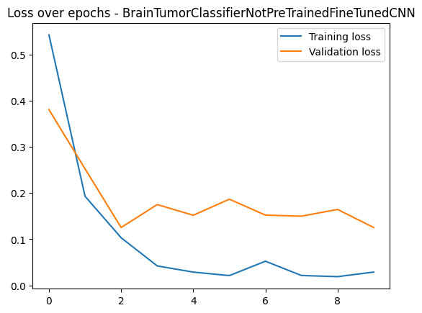
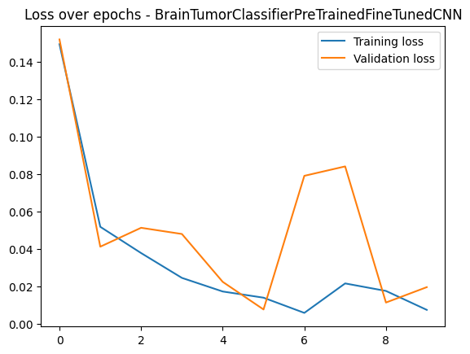
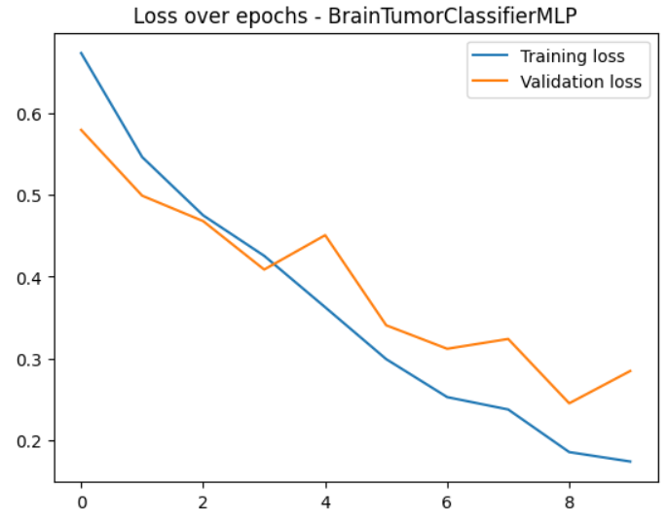
Models Evaluation
Each compared model was evaluated using loss and accuracy metrics for each epoch on both the training and validation datasets. As shown in the graphs, the CNN model did not converge within the limit of 10 epochs. High variance is observed in the not-pretrained Efficient Net model. Rapid loss decrease is demonstrated in the pretrained Efficient Net model.

Slide 13
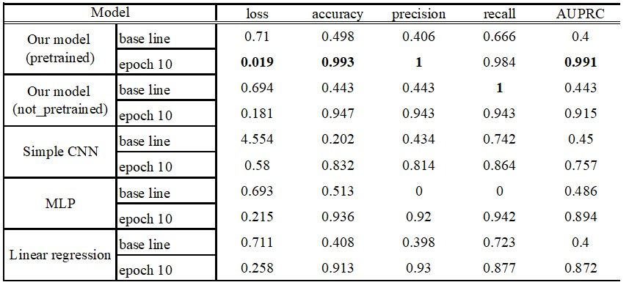
Results

Slide 14

Conclusions
Model Performance: Efficient Net B0 stands out, exhibiting rapid loss reduction and faster convergence within a constrained epoch framework, outperforming all other models tested.
CNN Limitations: Exhibited a slower rate of loss decrease, which impacted their effectiveness. Notably, when it is underperformed even when compared to simpler models such as MLP and Linear Regression.
Transfer Learning Advantage: Models that utilize transfer learning tend to outperformed those with uninitialized weights, benefiting from a 'head start' by using patterns learned previously.
- to investigate the size of the tumor, its stage of development and more

